Slide 1
Reflection
CHAPTER 10 :part 1
Notes:
Hi students. In this chapter, we are going to learn all about reflection and refraction of light.

Slide 2
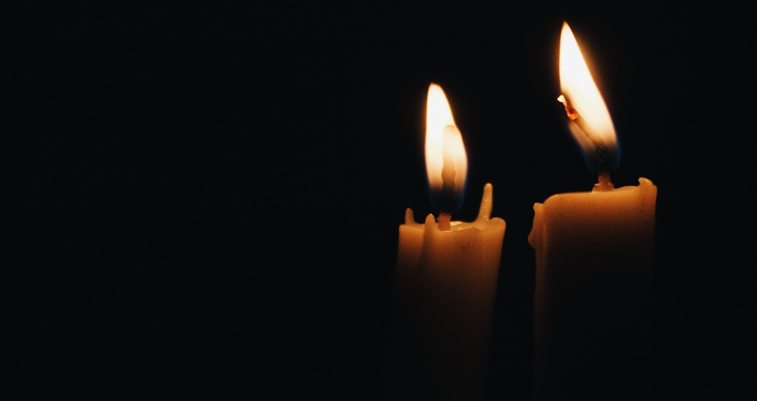
What is Light?
Light is a form of energy, which enables us to see an object.
Notes:
Now ,what is light?
Light is a form of energy which enables us to see objects and the straight line along which it travels is called ray of light.

Slide 3
Reflection of Light
When the light is allowed to fall on highly polished surface, such as mirror, most of the light gets reflected.
Notes:
Now that we know what light is,let us now learn about Reflection.
Reflection of Light is the process of sending back the light rays which falls on the surface of an object and the image formed due to reflection of an object on a plane mirror is at different places. It is the bouncing back of the energy back into the same medium after striking a surfaceFor eg: We are able to see objects only when the reflected light from the object are received by our eyes.

Slide 4
Laws of Reflection
The angle of incidence ∠i = ∠r.
The incident ray, reflected ray and the normal to the reflecting surface at the point of incidence lie in the same plane.
Notes:
Laws of reflection has been practically proved.
So the first law of reflection says that, the angle of incidence denoted by i, and the angle of reflection denoted by r , are equal.
∠i = ∠r.
The second law says that The incident ray, reflected ray and the normal to the reflecting surface at the point of incidence lie in the same plane. Note that all the three meet at the point of incidence.

Slide 5
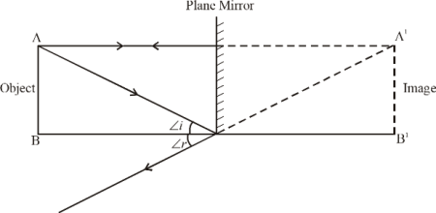
Image formed by Plane Mirror
1. Virtual (imaginary) & Erect image
2. Laterally inverted image
3. The size of image is equal to that of object.
4. The image formed is as far behind the mirror as the object is in front of it.
Notes:
The image formed by a plane mirror is another important topic .
Let us first understand what is the difference between virtual and erect image.
A Virtual image is an image that is not formed on screen. It is said to be imaginary and is formed behind the mirror .
The image is of the same size as that of the object and the distance between the object and the mirror is the same as the distance between the mirror and the virtual image of it formed behind the mirror.
Notice that the reflected rays appear to the observer to come directly from the image behind the mirror. In reality, these rays come from points on the mirror where they are reflected. The image formed behind the mirror is called a virtual image.This image cannot be projected onto a screen.The rays only appear to originate from a common point behind the mirror. If you walk behind the mirror, you cannot see the image, because the rays do not go there. However, in front of the mirror, the rays behave exactly as if they come from behind the mirror, so that is where the virtual image is located.
Now , A Laterally inverted image is an image which is a copy of the object formed at the location from which the light rays appear to come i.e behind the mirror. This image is a "mirror image" of the object. If a person is reflected in a plane mirror, the image of his left hand appears to be the right hand of the image.
We will now loom into spherical mirrors in the next lecture.

